Slide 1
Object Oriented Programming
Lec: 01

Slide 2
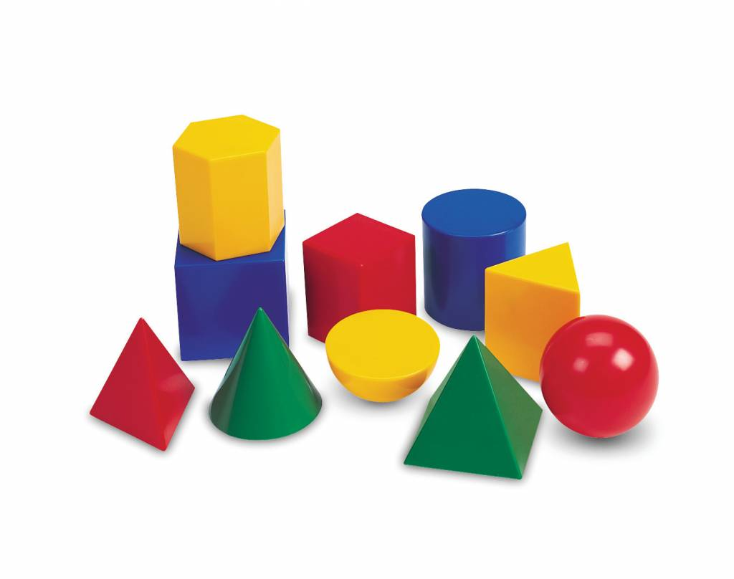

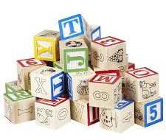
Object
A tangible thing that we can sense, feel, and manipulate.
The earliest objects we interact with are typically baby toys including Wooden blocks, plastic shapes, and over-sized puzzle pieces are common first objects.
Software objects are not typically tangible things that you can pick up, sense, or feel. Formally, an object is a collection of data and associated behaviors.

Slide 3
object-oriented?
Oriented simply means directed toward.
Object-oriented means functionally directed towards modeling objects. This is one of the many techniques used for modeling complex systems by describing a collection of interacting objects via their data and behavior.

Slide 4
object-oriented Umbrella
object-oriented analysis and design, and object-oriented programming. These are all highly related concepts under the general object-oriented umbrella.
Object-oriented analysis (OOA) is the process of looking at a problem, system, or task (that somebody wants to turn into an application) and identifying the objects and interactions between those objects.
Object-oriented design (OOD) is the process of converting such requirements into an implementation specification. The designer must name the objects, define the behaviors.
Object-oriented programming (OOP) is the process of converting this perfectly defined design into a working program

Slide 5
Class and Object
A class is considered as a blueprint of objects. For example, you can think a class as a sketch (prototype) of a house. It contains all the details about the floors, doors, windows, etc. Based on these descriptions we build the house. House is the object.
Since many houses can be made from the same description, we can create many objects from a class.
An object is called an instance of a class. An object is a collection of data with associated behaviors.

Slide 6
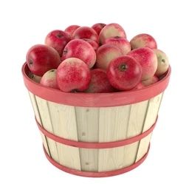
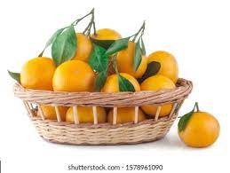
Cont.
Apples and oranges are both objects. To differentiate both the objects Assume that apples go in barrels and oranges go in baskets.
Object_1
Object_2
Object_3
Object_4

Slide 7
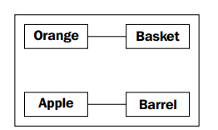
Unified Modeling Language
The relationship between the four classes of objects can be described using a Unified Modeling Language or UML
This diagram shows that an Orange is somehow associated with a Basket and that an Apple is also somehow associated with a Barrel

Slide 8
Specifying attributes and behaviors
An object instance is a specific object with its own set of data and behaviors; a specific orange on the table in front of us is said to be an instance of the general class of oranges. That's simple enough, but what are these data and behaviors that are associated with each object?

Slide 9
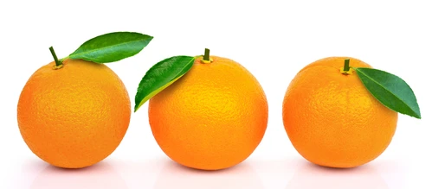
Data describes objects
A class can define specific sets of characteristics that are shared by all objects of that class.
Any specific object can have different data values for the given characteristics.
For example, three oranges on the table could each weigh a different amount.

Slide 10
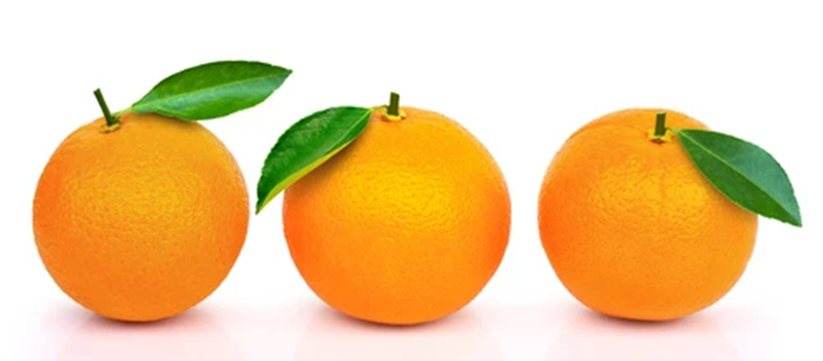
Cont.
The orange class could then have a weight attribute. All instances of the orange class have a weight attribute, but each orange has a different value for this attribute.
Attributes don't have to be unique, though; any two oranges may weigh the same amount.
140 grams
120 grams
90 grams

Slide 11
Define Python Class
We use the class keyword to create a class in Python. For example,
class ClassName:
# class definition
Let's see an example,
class Bike:
name = ""
gear = 0

Slide 12
Python Objects
An object is called an instance of a class. For example, suppose Bike is a class then we can create objects like bike1, bike2, etc from the class.
Here's the syntax to create an object.
objectName = ClassName()
Let's see an example,
# create class
class Bike:
name = ""
gear = 0
# create objects of class
bike1 = Bike()

Slide 13
Access Class Attributes Using Objects
We use the [.] notation to access the attributes of a class. For example,
# modify the name attribute
bike1.name = "Mountain Bike"
# access the gear attribute
bike1.gear
Here, we have used bike1.name and bike1.gear to change and access the value of name and gear attribute, respectively.

Slide 14
Example 1: Python Class and Objects
# define a class
class Bike:
name = ""
gear = 0
# create object of class
bike1 = Bike()
# access attributes and assign new values
bike1.gear = 11
bike1.name = "Mountain Bike"
print(f"Name: {bike1.name}, Gears: {bike1.gear} ")
Output
Name: Mountain Bike, Gears: 11

Slide 15
Create Multiple Objects of Python Class
# define a class
class Employee:
# define an attribute
employee_id = 0
# create two objects of the Employee class
employee1 = Employee()
employee2 = Employee()
# access attributes using employee1
employee1.employeeID = 1001
print(f"Employee ID: {employee1.employeeID}")
# access attributes using employee2
employee2.employeeID = 1002
print(f"Employee ID: {employee2.employeeID}")
Employee ID: 1001
Employee ID: 1002

Slide 16
For practical purpose
Anaconda: https://anaconda.org/
Jupyter notebook

